Slide 1
AI Construction Tools: Optimizing Every Stage of Construction
Week of February 16th
Elias Hord

Slide 2
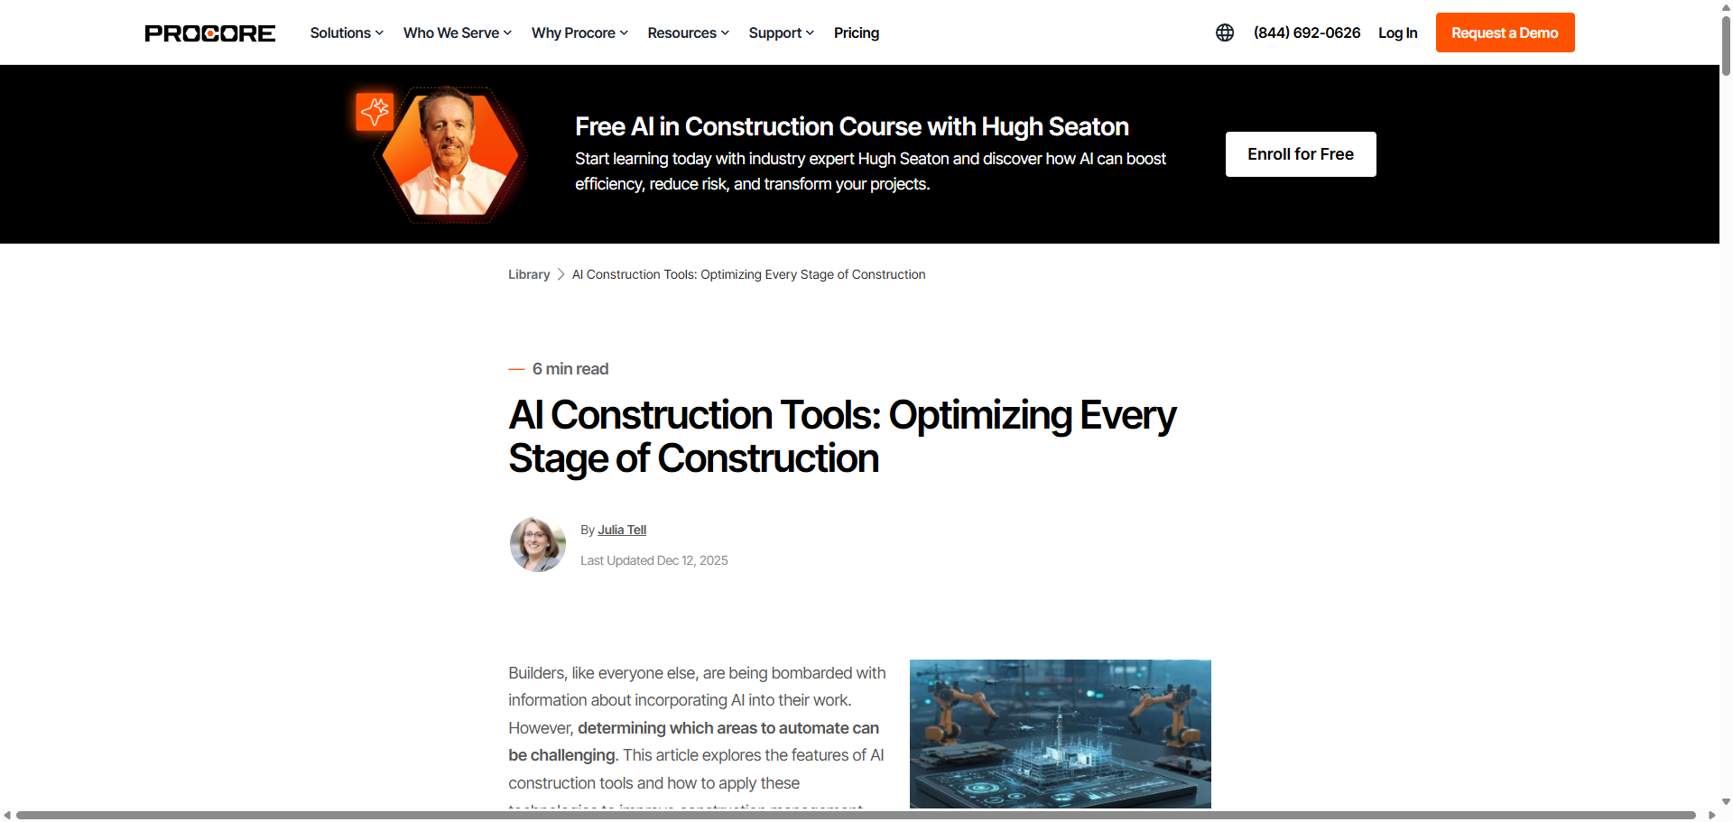
General Information
Article Publication: December 12, 2025
https://www.procore.com/library/ai-construction-tools

Slide 3
Main Findings and Arguments
AI tools are transforming construction by automating repetitive tasks, enhancing data analysis, and improving decision-making across the full project lifecycle—from preconstruction through field operations. These tools leverage advanced technologies such as machine learning (ML) to learn from historical data, natural language processing (NLP) to interpret human language, and predictive analytics to forecast issues before they occur.
The article highlights a wide range of AI applications, including:
Preconstruction estimating and quantity takeoffs that reduce errors and speed up early planning.
Design and planning support via AI-enhanced BIM tools that predict costs and optimize layouts.
Project management systems that adapt schedules in real time.
Field monitoring, safety surveillance, and site documentation using AI-powered visibility tools.
Supply chain optimization, equipment maintenance forecasting and robotic automation of physical tasks.
The authors argue that these technologies not only boost efficiency and cut costs, but also significantly enhance safety and data-driven insights, elevating the overall performance of construction projects.

Slide 4
Broader Implications for Society
AI adoption in construction has impacts beyond individual job sites:
Workforce Transformation
AI can help address labor shortages and reduce reliance on manual labor by automating routine tasks. This could shift the workforce toward higher-skill roles involving oversight, strategy, and complex problem-solving.
Safety and Public Outcomes
Safer job sites benefit workers and surrounding communities, reducing injuries and potentially lowering insurance and medical costs. Real-time monitoring and hazard detection can make construction environments much safer and responsive.
Data-Driven Infrastructure
Digitization of construction data supports better facility operations and maintenance after project completion, potentially improving infrastructure longevity and efficiency
Ethical and Privacy Considerations
As seen in broader industry reporting, AI’s use of real-time monitoring and large volumes of data raises concerns about privacy, data security, and worker autonomy, requiring careful governance and transparent practices.

Slide 5
Relevance or Potential Influence on the Construction Industry
Competitive Pressure
AI tools are quickly becoming a competitive necessity. Firms that adopt AI are able to deliver projects with less waste, lower costs, and better safety records, while those that lag risk losing bids and market share.
Improved Project Outcomes
AI-powered tools can identify risks such as schedule delays, cost overruns, and safety hazards before they become problems, leading to more predictable and efficient project delivery.
Shift in Roles and Skills
The industry will likely need a workforce with stronger digital literacy, capable of interpreting AI-generated insights and integrating them into project decisions. This may reshape training and hiring practices.
Integration with Existing Software
Many construction platforms (such as Procore) are embedding or partnering with AI components to offer centralized, AI-augmented project management, signaling that AI will become standard in construction tech stacks.
Future Outlook
The article suggests that AI will continue to evolve—introducing greater automation (e.g., robotics, autonomous drones) and deeper predictive insights—ushering in a smarter, more collaborative era of construction.

